Slide 1

YouTube Transcript Summarizer
YouTube Transcript Summarizer
by
A. Dhana Lakshmi
Roll No. 214G1A0519
Department of Computer Science and Engineering
Srinivasa Ramanujan Institute of Technology
Autonomous
Rotarypuram Village, B K Samudram Mandal, Ananthapuramu – 515701.
2023-2024
A-13
1

Slide 2

Contents
YouTube Transcript Summarizer
Abstract
Introduction
Project Explanation
Conclusion
References
A-13

Slide 3
Abstract
YouTube Transcript Summarizer
People who are watching YouTube videos daily which can be educational, documentary or of any genre with longer length which will consume more time. The "YouTube Transcript Summarizer" helps to save time by creating summarized content. This project is a Python-based application that utilizes the Spacy open-source library to generate summarized text from YouTube videos. Spacy offers the capabilities of parsing through words and identifying parts of speech, identifying noun chunks and verbs, etc. This project uses the YouTube Transcript API library to extract video information, including transcripts. The generated summary is displayed to the user through a Streamlit library, providing a user-friendly interface for quick and easy understanding of the main points of a video without having to watch the entire thing. Overall, this project is a useful for researchers, students, and anyone looking to save time by quickly understanding the content of YouTube videos.
Keywords : Python, Spacy, YouTube Transcript API, Streamlit
A-13

Slide 4
Introduction
YouTube Transcript Summarizer
Imagine you come across an interesting YouTube video, but you don't have time to watch the entire thing. That's where our project comes in.
We've built an application that takes the URL of a YouTube video and percentage of summarization which gives you a quick transcript and easy-to-understand summary.
It's like reading the highlights of a book instead of going through every page.
Using technologies like Spacy and Streamlit, our project aims to make YouTube content more accessible, saving you time and helping you find the information you need faster.
A-13

Slide 5
Back End
YouTube Transcript Summarizer
We create a back-end application directory containing virtual environfiles
We created a virtual environment. A Python Virtual Environment is an isolated space where you can work on your Python projects, separately from your system-installed Python.
We use ‘venv’ to create a virtual environment in Python. venv creates a folder that contains all the necessary executables to use the packages that a Python project would need.
After creating a virtual environment, we need to activate it.
A-13

Slide 6
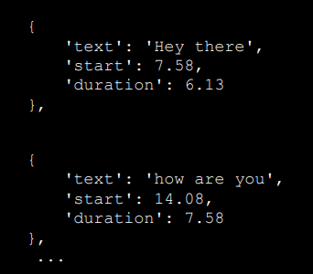
Get Transcript
YouTube Transcript Summarizer
Here we are utilizing a python API i.e., YouTubeTranscriptApi which allows you to get the transcripts/subtitles for a given YouTube video.
In this module we have a function called get_transcript() which will accept YouTube video id as an input parameter and return parsed full transcript as output.
we get the transcript as a collection of dictionaries in
a list data structure with keys text, start and duration
So, we extract only the ‘text’ from the response
to return the transcript in whole string format.
A-13

Slide 7
Text Summarization
YouTube Transcript Summarizer
Text summarization is the task of shortening longer text into a precise summary that preserves key information content and overall meaning.
In our Project we use Spacy Summarization algorithm which is a Frequency Based Approach.
Spacy is a popular open-source library for natural language processing (NLP) in Python. It offers powerful features for text processing and analysis that can be utilized for summarization tasks.
Stopwords are often removed during text processing to reduce noise and focus on the more meaningful words in a document.
This algorithm calculates the frequency of each meaningful words in transcript then it will assign the frequency to each sentence based on the frequency of words in that sentence.
A-13

Slide 8
Text Summarization
YouTube Transcript Summarizer
Based on the Summarization percent it will calculate the select_length value.
The ‘nlargest’ function from the ‘heapq’ module in Python is used to find the n largest elements from a list. It's often used to find the top N elements based on a specific criterion.
The ‘nlargest’ function gives output in the form of list.
By using join() function we join the values of this list into one paragraph and displays the summary.
A-13

Slide 9
Front End
YouTube Transcript Summarizer
Streamlit is a Python library which provides a user-friendly interface that makes it easy to create an interactive web applications.
Streamlit applications often interact with a backend (if needed) through APIs (Application Programming Interfaces) or by directly integrating backend logic within the Streamlit script.
In our project we are directly integrating backend logic within Streamlit script.
Streamlit runs a local development server that hosts your application.
By default, it starts the server on http://localhost:8501/, and you can access your app by opening this URL in your web browser.
A-13

Slide 10
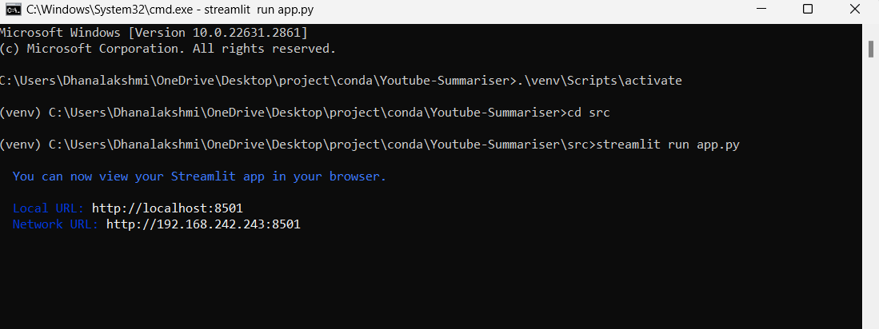
Output
YouTube Transcript Summarizer
A-13

Slide 11
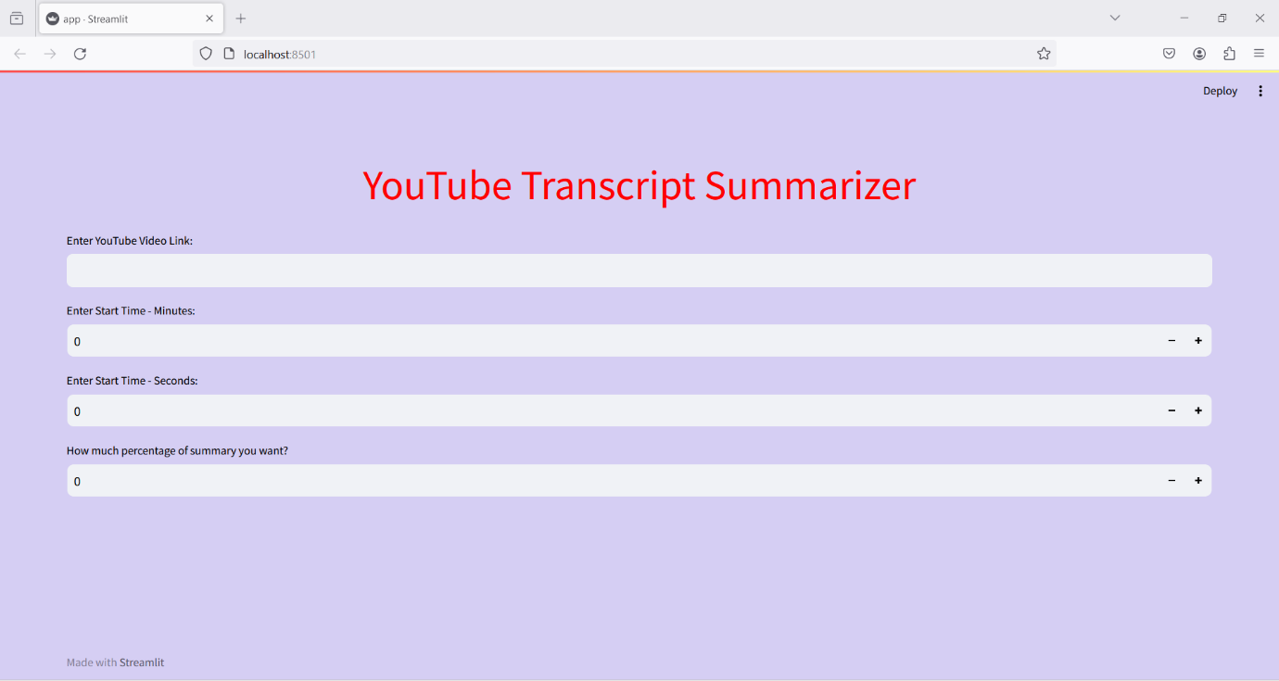
Output
YouTube Transcript Summarizer
A-13

Slide 12
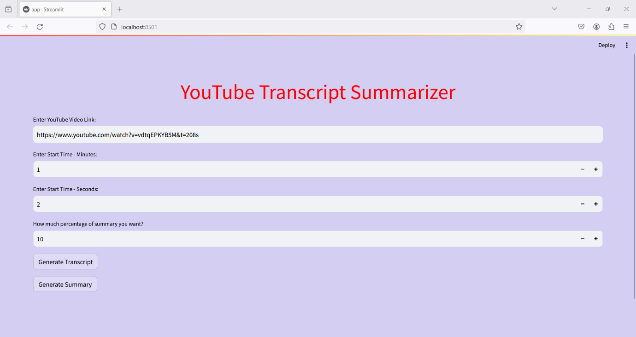
Output
YouTube Transcript Summarizer
A-13

Slide 13
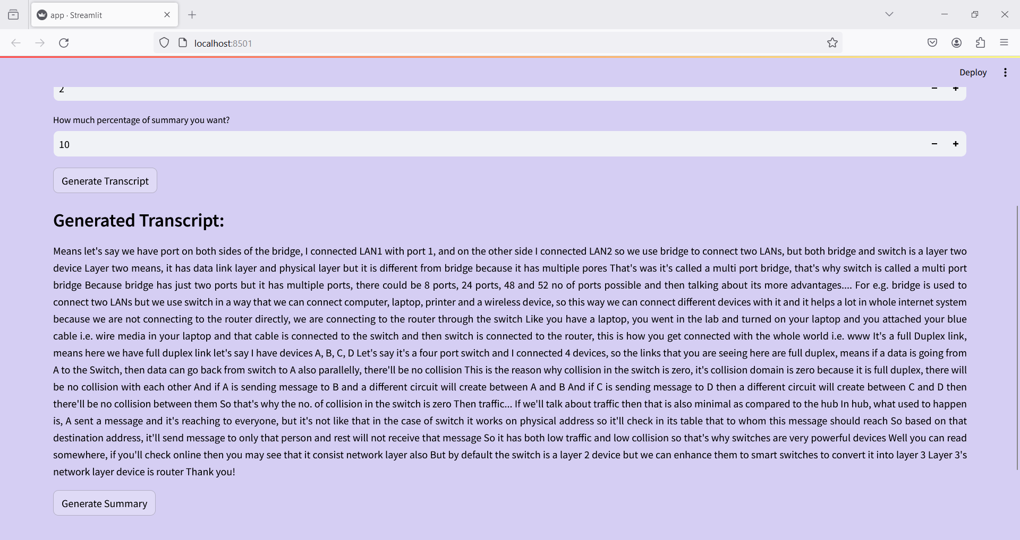
Output
YouTube Transcript Summarizer
A-13

Slide 14
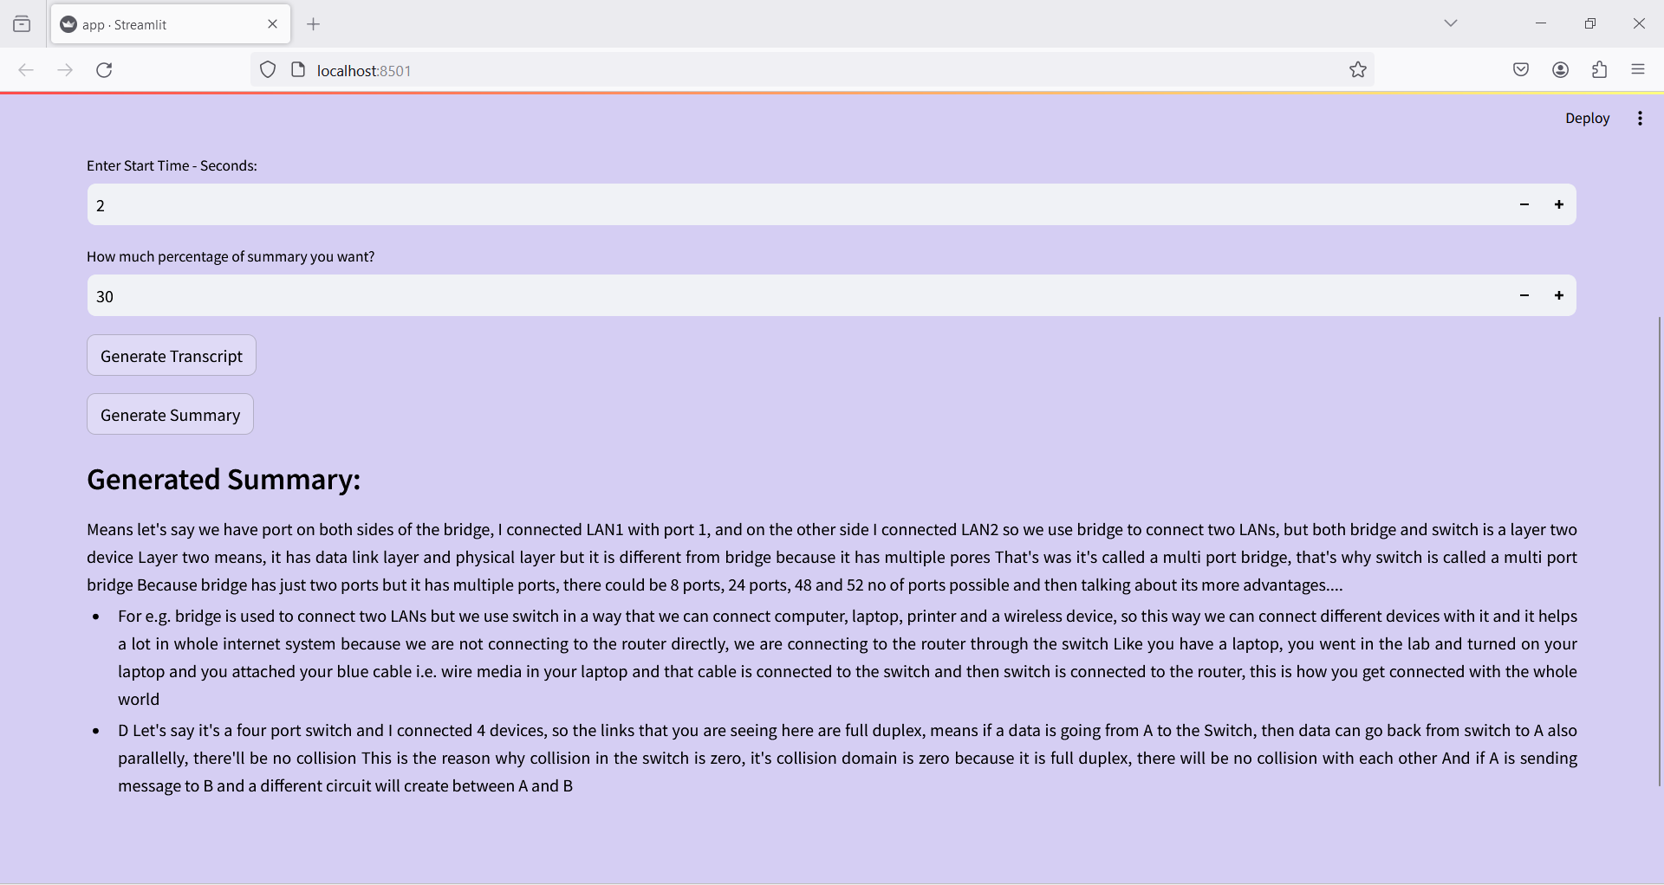
Output
YouTube Transcript Summarizer
A-13

Slide 15
Conclusion
YouTube Transcript Summarizer
The YouTube Transcript Summarizer offers an efficient solution for condensing lengthy video content into concise text summaries. By using spacy module, we can extract key insights, main points, and important information from videos, enabling users to quickly grasp the essence of the content without having to watch the entire video.
This is particularly valuable in today's fast-paced digital landscape, where time is often limited, and users are constantly seeking efficient ways to consume content.
Overall, it enhance the user experience, providing a streamlined and efficient approach to accessing and comprehending video content.
A-13

Slide 16
References
youTube Transcript Summarizer
https://ijcrt.org/papers/IJCRT22A6393.pdf
https://www.geeksforgeeks.org/python-virtual-environment/
A-13

Slide 17
Process Mining Virtual Internship
Thank You!!!
A-13

